Slide 1
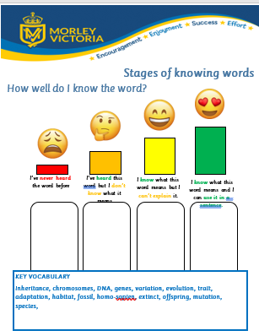
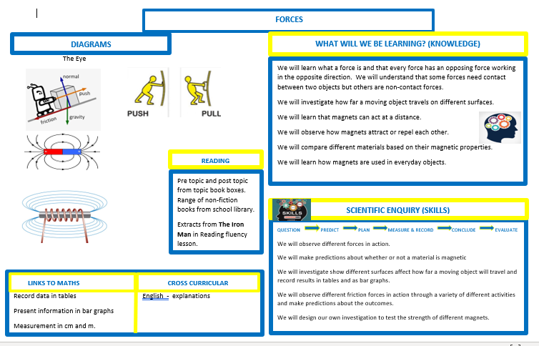
Knowledge Organisers and the Stages of Knowing Words
Parent Presentation

Slide 2

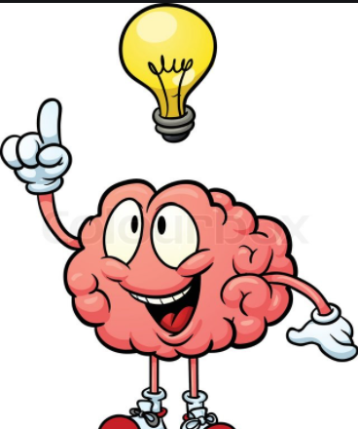
Short term memory to long term memory
Our short term memory can only hold a certain amount, however our long term memory has no limits to the amount of information it can store so we need to use strategies in the classroom and at home to ensure learning is laid down in to long term memory.
There are many arguments made for the necessity of the memorisation of important knowledge. Our working memory capacity is limited, so by storing more in our long-term memory, we can free up working memory capacity (Paas et al., 2004).

Slide 3
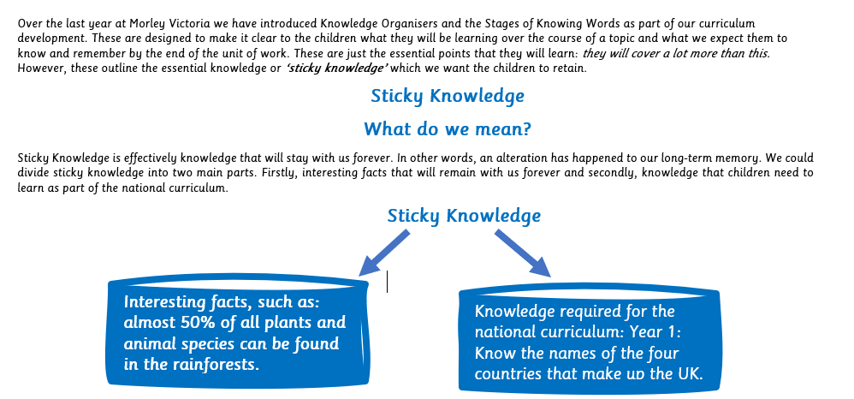

Slide 4
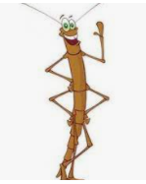
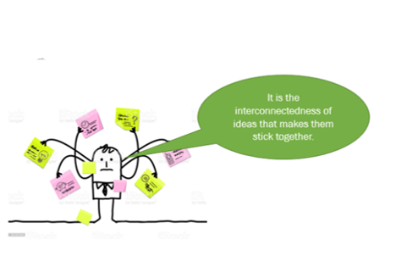
Making Knowledge Stick
Our curriculum builds on and connects to what has previously been learnt.
It builds progressively on what has been learnt before in that subject.
Children’s ability to learn is influenced by:
The complexity of the information
Links to prior knowledge and experiences
How we present the work
The amount of mental effort needed
Prior understanding of concepts (or schema)
Their understanding of vocabulary

Slide 5
Developing a concept – Empire
Gain and deploy a historically grounded understanding of abstract terms such as ‘empire’, ‘civilisation’, ‘parliament’ and ‘peasantry’ National Curriculum
An empire is a type of political unit. Throughout history countries have wanted to control lands beyond their borders. ... Such a country and the lands it controls are called an empire
The concept is built upon throughout each unit, with a particular in depth focus in certain year groups e.g. The Roman Empire in year 3. Some example questions which help children make connections are below?
Does the queen still reign over the British Empire?
Did only Roman soldiers fight in the Roman Empire?
When did Greece become an Empire?
Why did Egyptian artefacts end up in the British Museum? (Link to British Empire)
Did only British soldiers fight in the Battle of Britain? (Links to British colonies etc)
Did Hitler want to copy the Roman Empire?
What was HMT Empire Windrush?
This progression and links allows children to develop an understanding of a concept or ‘schema’ such as Empire across school.

Slide 6
Subject Specific Skills
As well as a progression of knowledge each subject has a specific set of skills or ‘procedural concepts’ associated with the subject.
Our curriculum ensures that these skills are progressed year upon year in addition to linking the knowledge.
History skills
History skills or ‘procedural concepts’ include:
Chronology
Historical enquiry
Cause and Consequence
Change and continuity
Significance
Interpreting Evidence
Comparison

Slide 7
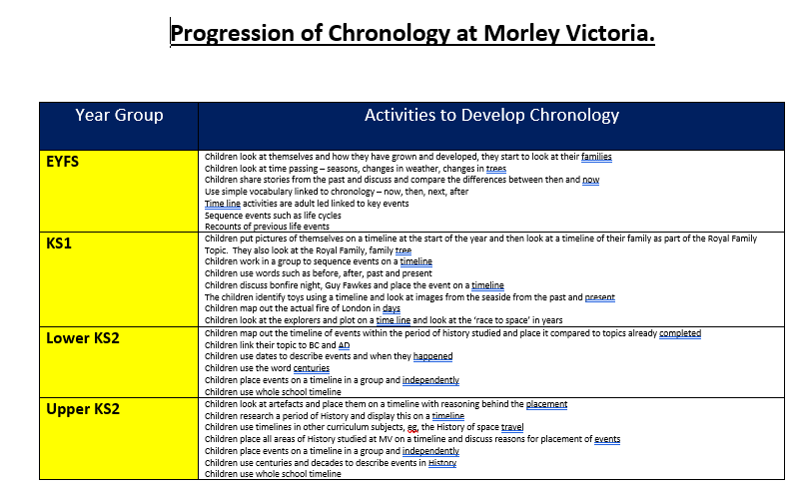
An example of how the strand of chronology progresses

Slide 8
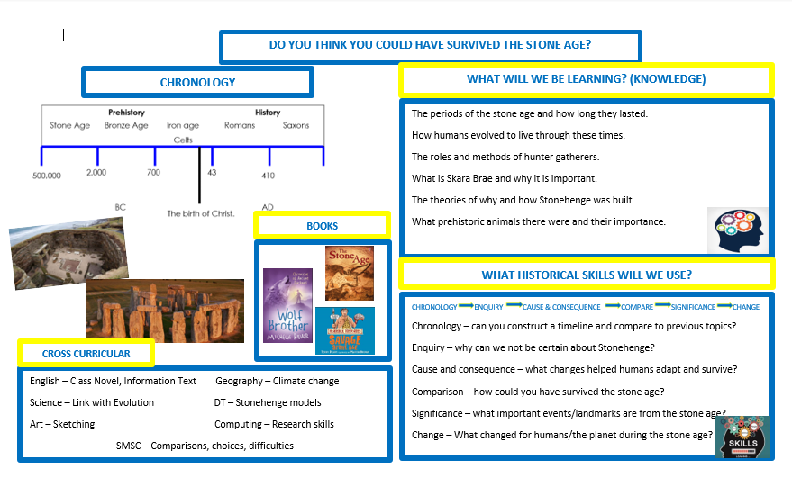
Knowledge Organisers
Our knowledge organiser is divided into three areas:
Key knowledge to be learnt.
How the skills will be applied
Links to other subjects.
This is the minimum of what will be learnt

Slide 9
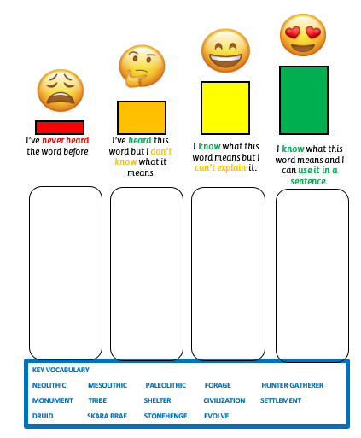
The Stages of knowing words outlines the key vocabulary that will be learnt throughout the topic.
Children complete this at the beginning and at the end and reference throughout the topic.
This, alongside the knowledge organisers, give children the ‘bigger picture’ and they can learn in advance or use as a reference point before, during and after the topic.

Slide 10
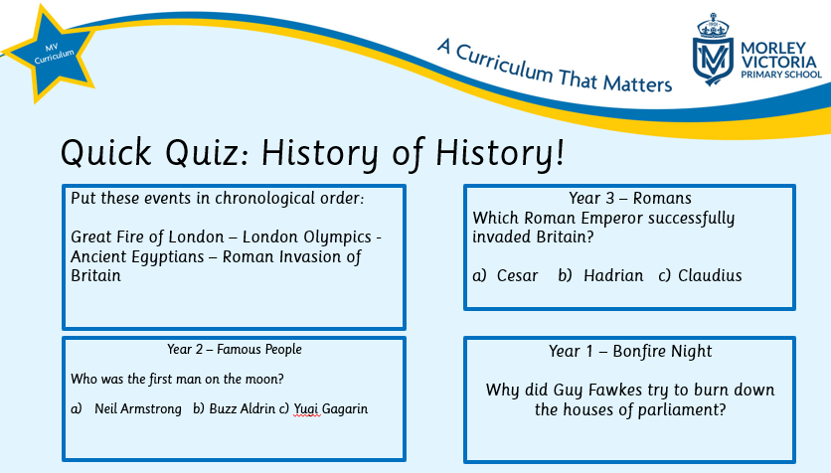
Checking prior knowledge – Low stakes quizzes
Each lesson will start with a fun low stakes quiz from learning done in previous years on the subject.
This helps previous knowledge ‘stick’ but also allows for discussions, addressing misconceptions and making links to new learning.

Slide 11
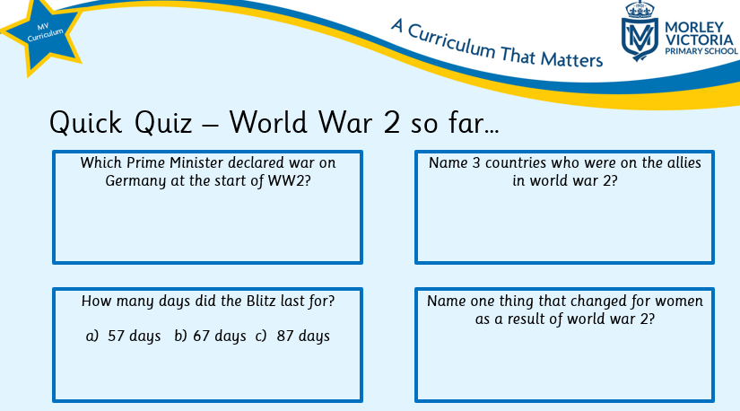
Checking prior knowledge – Low stakes quizzes
There ill then be a low stakes quiz recapping ‘sticky knowledge’ on what had already been learnt.
This is another opportunity to address misconceptions, make links and have discussions bringing in children’s own knowledge.

Slide 12


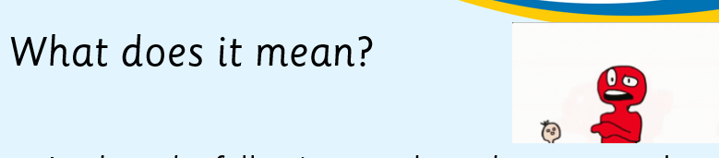

Checking prior knowledge – Low stakes quizzes
A vocabulary activity is then played in class on previous or forthcoming vocabulary.
Finally, reference is made to the driving skill of that particular lesson.

Slide 13
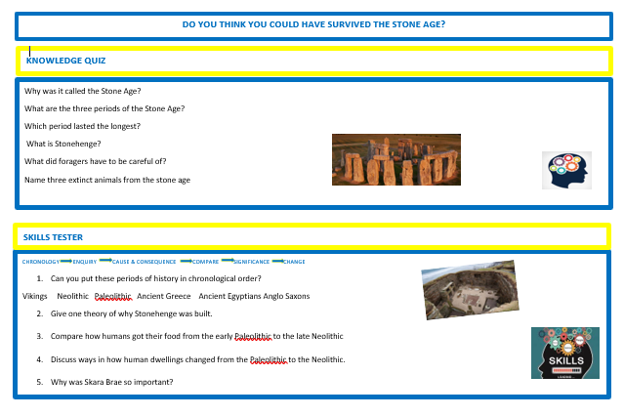
End of unit Quiz
The end of unit low stakes quiz then tests both the knowledge and understanding and the skills from that particular topic.

Slide 14


Memorable experiences and building on existing knowledge and experiences.

Slide 15
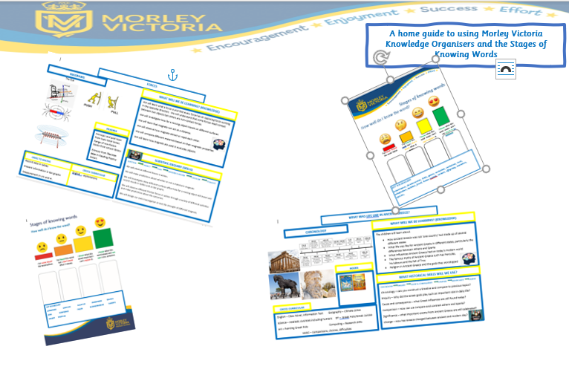
Supporting your child at home
On our school website is the parents guide with ideas to support your child at home.
https://www.morleyvictoria.leeds.sch.uk/curriculum-1/school-curriculum/template-do-not-delete-1-1-1-1-1-1-1-1-1-8-1-1-1-3-1-1-1-1-2-4-1-1-1-1-1-2-2-1-4

