Slide 1
Morley Victoria's
'Magnificent Seven'
Skills for Whole Class Reading

Slide 2
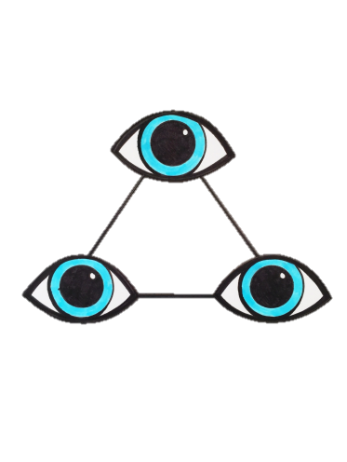






Visualise
Connect
Question & Predict
Monitor
Infer
Summarise
Evaluate
Notes:
Visualise
Be able to make mental pictures using their own knowledge and understanding of vocab – vocab development is king in this area, and allowing children to experience as much as possible
Posters for classrooms
Posters for children – these are to be stuck in their Reading Journal

Slide 3
Children learn to paint a mental picture as they read.
They use the senses to help them do this.
Vocabulary development and experiences are key to helping them do this.
Children are taught to explain which words and phrases helped them.
Visualise

Slide 4
Children make links between their own experiences and what they read.
Children make links and comparisons with other texts that they have read.
Learn to discuss and identify running themes in texts.
Connect

Slide 5
Children learn question what they read as they read it.
They think about what will happen next and consider why they think this will happen.
They learn to question other people about what they have read.
Question & Predict

Slide 6
Deals a little more with mechanics – does what they have read make sense to them?
Children can talk about the comprehension strategies they have used.
They develop strategies for how to fix a breakdown.
Monitor

Slide 7
Children need to be taught to find the details in a text.
They learn to be detectives and read between the lines.
They must be taught to use the text to back up their inferences – this starts verbally lower down.
Infer

Slide 8
Children learn to identify an ongoing theme.
They can give an overview of a passage, chapter or whole text that they have read.
They use their retrieval skills to find the key parts of a text.
Summarise

Slide 9
Children can discuss what they have read.
They talk about whether they liked a text.
They talk about the author’s use of language, organisation, style, motives when discussing texts.
Think about interlinking themes.
Evaluate

