Slide 1
Year 6 Reading Workshop
Mr Precious and Mrs Bode

Slide 2
Stamina in SATs
Read and understand 3 unseen extracts – this could be poetry, non-fiction or fiction. These could be linked to anything and not necessarily relevant to the children.
Read and understand 38 questions including several different question types.
Recognise what skill is needed to answer the question (prediction, interference, retrieval and deduction, word meaning)
Do all of this in an hour!

Slide 3
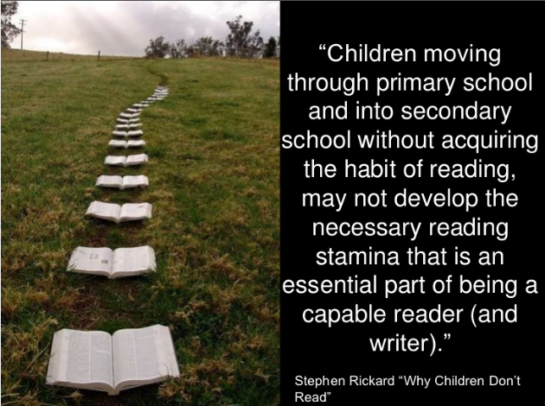
Reading Stamina

Slide 4

Reading Stamina

Slide 5
Our children as readers
What Do We Want for Our Children?
To read for pleasure
To be able to choose what they would like to read for themselves
To read with understanding (comprehension)
To read with expression
To be able to summarise what has been read
To have reasons for preferences in what they read

Slide 6
Active Reader
An active reader is a reader who:
pays attention to the reading and who draws conclusions
make predictions
imagines himself/herself as the character
re-reads passages that he/she does not understand
Thinking in the background and using their general knowledge to support understanding
This needs to be modelled in whole school reading, reading aloud, shared reading.

Slide 7
Key Stage 2 Reading Test 2018
22 marks came from domain: Make inferences from the text/explain and justify inferences with evidence from the text.
13 marks came from domain: Retrieve and record information/identify key details from fiction and non-fiction.
10 marks came from domain: Give/explain the meaning of words in context.
3 marks came from the domain: Summarise main ideas from more than one paragraph.
2 marks came from the domain: Make comparisons within the text.

Slide 8
Inference and deduction skills
Deduction is typically more factual based
Inference has an element of guesswork ‘Reading between the lines’
For example, if the police find a body in the library with a knife sticking out, the deduction would be that they had been murdered.
The inference would be that someone didn't like them.
In Kensuke's Kingdom, when water and food are left beside Michael the deduction is that someone else lives on the island.
The inference is that they care for Michael, but don't want him to know anything about them.

Slide 9
How Parents Can Help With Inference Skills - Inference Questions
How can you tell?
Why?
How do you know?
What evidence can you find?
Do you think?
In what ways?
According to the text?
What was the authors intention?

Slide 10
Vocabulary
1 in every 5 marks available were vocabulary questions.
These appeared in a number of formats including: ‘tick one answer’, ‘find and copy one word’, and ‘find and copy a group of words…’.
Vocabulary understanding needs to extend beyond the definition of single words and into understanding phrases and idioms.

Slide 11
Language Development
Extract 3 2018 – fiction
Fascination
Ancestors
Chamber pots
Basins
Generosity of space
Vast horse chestnut
Poignant
Bygone age
Elderly spinster
Guardian
Taken the car on business
Left to my own devices,
Most remote
Glancing idly
Recesses of the shelf
I reached in and drew it out
Pillar of stone
Fashioned by hand
Precisely
Dawned on me
Debris
Thick network of cobwebs

Slide 12
Thank you for coming along today.
If you have any questions please ask

