Slide 1
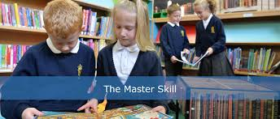
Reading – The Master Skill
Supporting your child with their reading at home
Year 2 and Year 3

Slide 2



Tip 1
We as adults must try to demonstrate:
a love of reading
the purpose for reading
excitement and enthusiasm for reading

Slide 3

Tip 2
Read with/to your child.
Read with/to your child at every opportunity
Children who are read to at least three times a week by a family member are almost twice as likely to score in the top 25% in reading compared to children who are read to less than 3 times a week (The Literacy Project, 2017)
Share stories, non-fiction books, poems, rhymes, newspapers, comic books, recipes, instruction manuals
Discuss words meanings and understanding of what you read to them

Slide 4
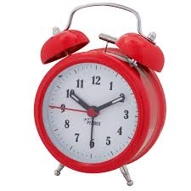
Tip 3
Where and When
Quiet environment
Minimal distractions
Time of day can make a big difference

Slide 5
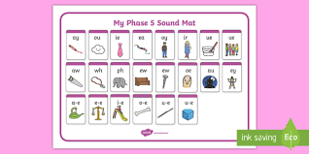
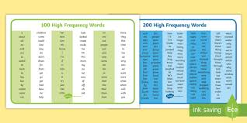
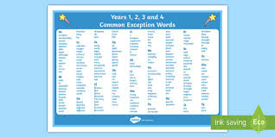
Tip 4
Practise
Little and often (it makes a difference)
Use phonics to sound out unfamiliar words
Alternative pronunciations
Increased knowledge of high frequency words
Common exception words

Slide 6
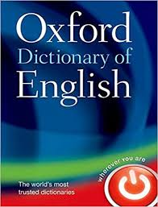
Tip 5
Making sense
Fluency, pace and smoothness
Making sense of words
Self-correcting
Understanding
Dictionary use

Slide 7
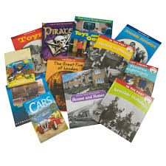

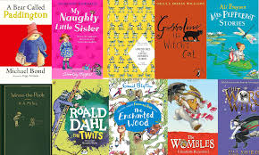
Tip 6
Balanced Diet
Fiction (Varied authors)
Non-fiction (comics, education newspapers, magazines, information books)
Poetry

Slide 8
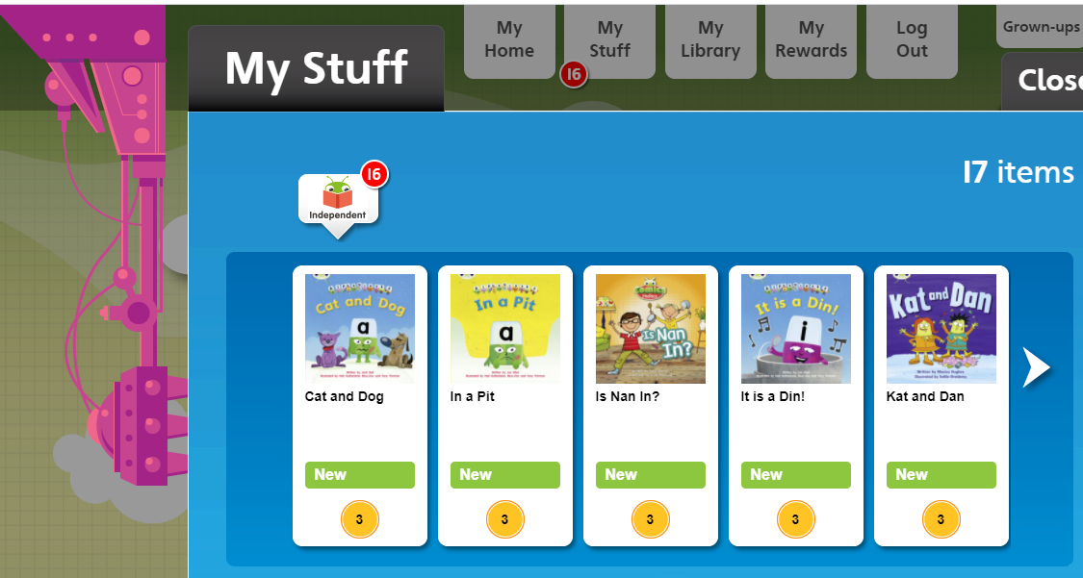
Tip 7
Use Active Learn
Little and often
Comprehension questions
3 times per week – minimum
Would be reading daily in school
Books match those in school
Set by teachers for your child’s level

Slide 9
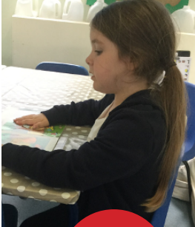
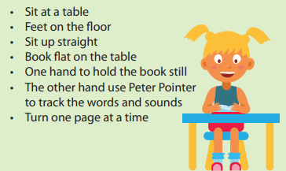
Tip 8
Reading Position

Slide 10
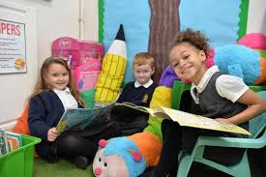
Tip 9
Reading for pleasure with understanding
Whole class reading
Stamina for reading
Question/inference
Connections
Reading is the gateway to all subjects

Slide 11
Tip 10
Magnificent 7 reading skills

Slide 12

Thank you for joining us!
Please direct any questions to your child’s class teacher and they will be happy to help.
Keep going, you are doing an amazing job!

