Slide 1
Reading – The Master Skill
Supporting your child with their reading at home
Years 4, 5 and 6

Slide 2
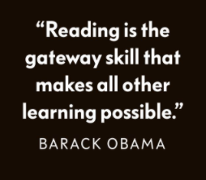
Children are still at the beginning of their reading journey – this journey should never end!

Slide 3
Tip 1
Read regularly
Model enthusiasm towards reading
Children may be tackling longer/more challenging
texts at this age
Little and often is still key – it is not a race!

Slide 4
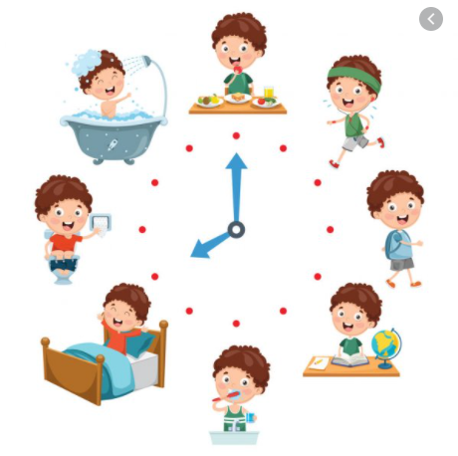
Tip 2
Reading Routine
Get into a regular routine for their reading – especially in the current climate (record this on the home reading record or use Bug Club)
Create a calm, special environment for your reading routine – no TV in the background!
Down devices before bed – use the time before bed as a reading time and switch off devices before bed

Slide 5
Tip 3
Still take an active role!
Even though they are older they still need you!
They need you to help model reading skills and being an ‘active’ reader.
I read a page then you read a page, be reading the same book as each other, listen to audiobooks of novels (especially more challenging texts) or simply read to them still!

Slide 6
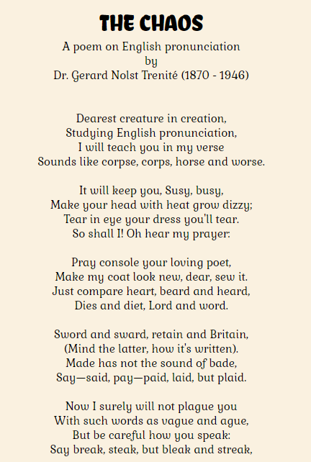
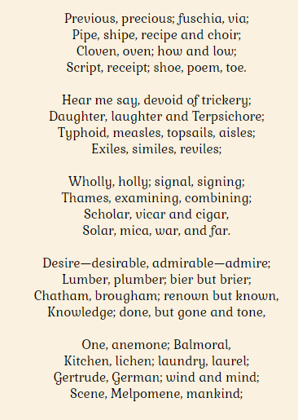

Slide 7
Tip 4
It’s OK to misread a word!
Most children will be past decoding words at
this age in their schooling.
However there will still be words children struggle with.
Allow them to know this is OK, as adults we still do this!

Slide 8
Tip 5
Develop a love of reading
For all the academic benefits –
books are designed to be enjoyed!
Reading for pleasure will increase stamina – they will go hand in hand.
As they move through school -and onto high school – stamina is crucial.

Slide 9
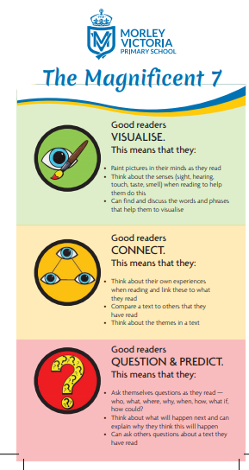
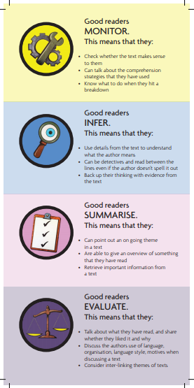
Tip 6
Reading Skills
As they get older children need
to read for understanding.
Use the ‘Magnificent 7’ bookmark
to identify and talk about these skills
with your child

Slide 10
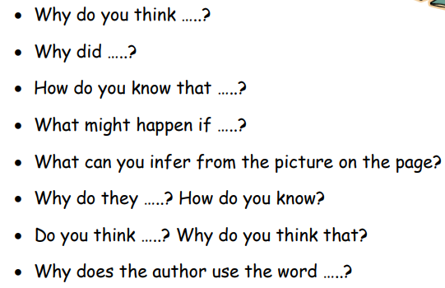
Tip 7
Inference
Often the most difficult skill to master/hardest question to answer for children.
Model this at every opportunity!
Show it is fine to have different inferences or more than one answer – this is what children often struggle with! Start a debate about it!

Slide 11
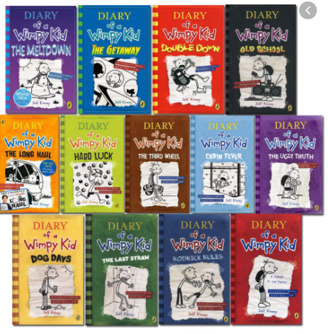
Tip 8
Range of texts
Children can often develop a preference for a certain genre or even author as they get older.
Need a diet of fiction, non-fiction and poetry.
Find texts once an interest has been sparked – such as a topic in school or even an interest in current affairs.

Slide 12
Tip 9
Talk about books
Make links to the setting, characters, plot etc through their own experiences, things they have learnt in school, seen on TV or other books they have read.
Talk about these before, during and after reading – this will help the children make connections and aid with their understanding

Slide 13
Tip 10
Vocabulary
Even if they can read it they may not understand it!
Look at the surrounding words, what could it be replaced with?
Is their a familiar root word? e.g. Faithfulness
Prefix or Suffix? e.g. Predetermine
Have a thesaurus and a dictionary at hand to explore the vocabulary and then use it again and again!

Slide 14
Thank you for joining us!
Please direct any questions to your child’s class teacher and they will be happy to help.
Keep going, you are doing an amazing job!

